Slide 1
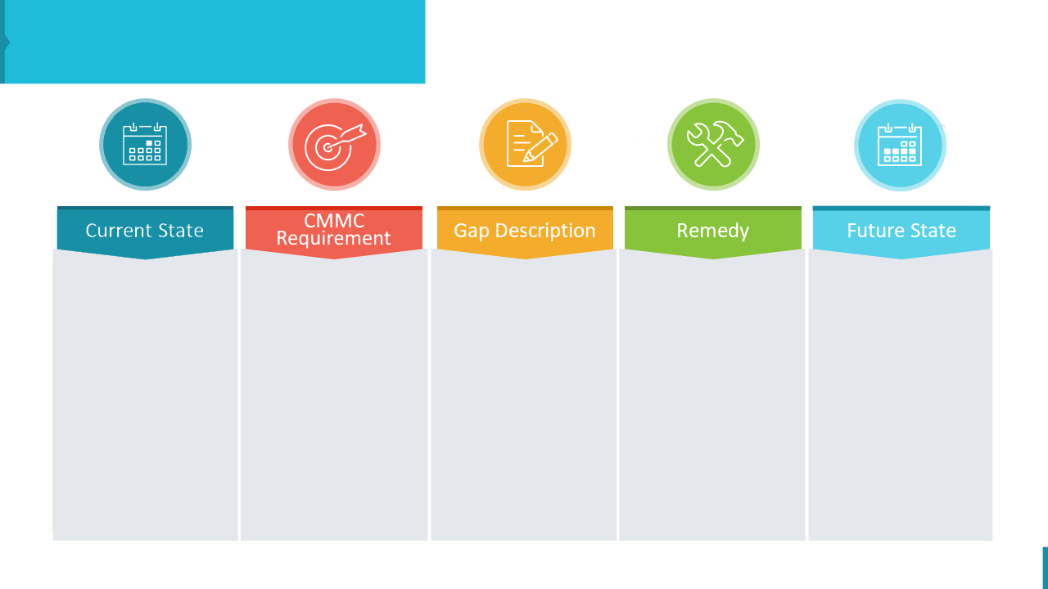
Template for Gap Analysis Presentation
Policy - Access Control Policy
Currently, the university IT department only requires a username and password for access, with no MFA in place.
CMMC Level 2 requires MFA for all access to systems containing CUI to ensure that only authorized users can access sensitive information.
Lack of Multi-Factor Authentication (MFA) for systems handling Controlled Unclassified Information (CUI).
Update the Access Control Policy to mandate MFA for all systems accessing CUI.
Deploy MFA solutions across relevant systems within the next 90 days.
Train IT staff and users on MFA implementation and usage.
Implement MFA for all systems containing or accessing CUI, enhancing the security of access controls

